Slide 1

Vel Tech Rangarajan Dr. Sagunthala R&D Institute of Science and Technology
School of Computing
Department of Computer Science and Engineering
10211CS224 / FULL STACK APPLICATION DEVELOPMENT (JAVA)
PROJECT REVIEW : MILESTONE PROJECT – 1
Date:25-03-26
ACADEMIC CAMPUS EVENT MANAGEMENT SYSTEM
SDG: 4 – Quality Education
Presented By:
J.Rithik Reddy – VTU25092 – 23UECS0744
Courses Handling Faculty:
Dr.S.Hemamalini – M.E,Ph.D
Assistant Professor(Senior Grade)

Slide 2
.
INTRODUCTION
1
In many academic institutions, event registration and management are handled manually or through unorganized systems.
This leads to confusion, duplicate registrations, and difficulty in tracking student participation.
Managing event deadlines and maintaining accurate records becomes challenging for administrators.
The Academic Campus Event & Registration Portal provides a centralized digital solution.
It allows students to securely register for events and view their participation history.
Administrators can monitor registrations, generate reports, and manage event details efficiently.
The system ensures transparency, prevents duplicate registrations, and enforces deadline validation.
This project supports digital campus transformation and enhances overall academic engagement.
2
3
4
5
6
7
8
9

Slide 3
PROBLEM STATEMENT
1
Academic institutions conduct multiple technical, cultural, and sports events throughout the year.
Managing registrations manually or through informal methods leads to data mismanagement.
Students may register multiple times or miss deadlines due to lack of proper tracking.
Administrators face difficulty in monitoring participant lists and generating reports.
There is no proper mechanism to prevent duplicate registrations and enforce deadline validation.
Event participation records are not centrally stored or easily accessible.
The absence of validation mechanisms affects transparency and efficiency.
Hence, a structured and automated event registration system is required.
2
3
4
5
6
7
8
9

Slide 4
OBJECTIVE(S)
1
To design and develop a web-based Academic Campus Event & Registration Portal for automated event management.
To implement secure login, duplicate registration prevention, deadline validation, and real-time report generation for students and administrators.
2
3
4
5
6
7
8
9

Slide 5
PROPOSED SYSTEM
1
The system is a web-based Academic Campus Event & Registration Portal.
It allows students to securely register and log in to view available events.
Students can register for events with duplicate prevention and deadline validation.
Admin can log in separately to manage and monitor all event registrations.
The system automatically stores and manages data in a centralized database.
Real-time registration reports are generated for both students and admin.
The portal improves transparency and reduces manual errors.
It ensures secure, efficient, and organized event management.
2
3
4
5
6
7
8
9

Slide 6
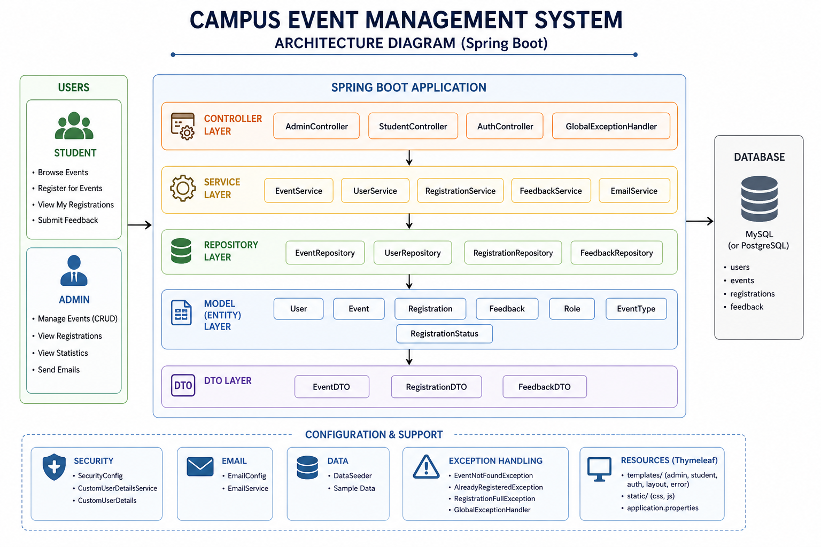
PROPOSED SYSTEM ARCHITECTURE
Input: User login details, event selection, registration requests.
Processing: Authentication, duplicate registration check, deadline validation, data retrieval and report generation.
Database: Stores student details, admin details, event information, and registrations.
Output: Registration confirmation, error messages, student report, and admin summary report.
1
2
3
4
5
6
7
8
9

Slide 7
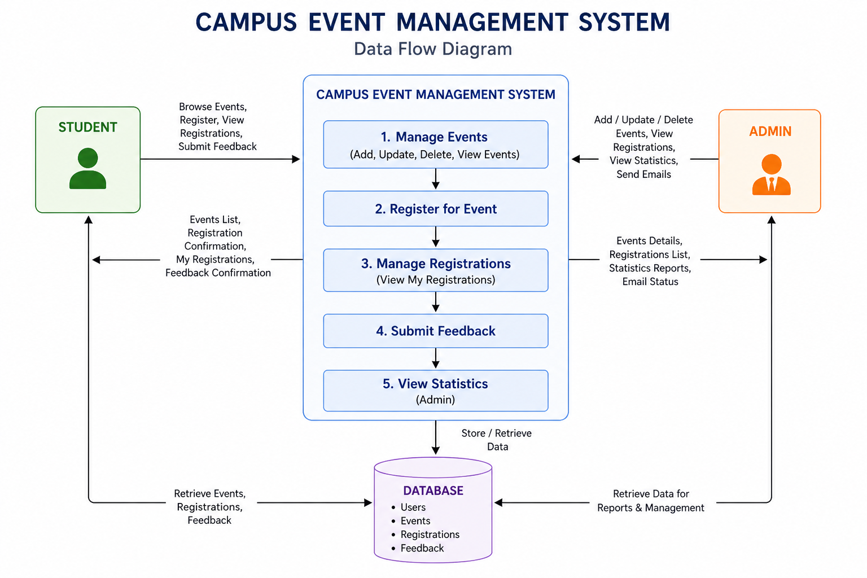
WORKFLOW
1
2
3
4
5
6
7
8
9

Slide 8
TECHNOLOGIES USED
1
Frontend: - HTML5, CSS3,Thymeleaf,JavaScript (ES6)
Backend: - Java (Spring Boot),Spring MVC,Spring Security,Spring Data JPA (Hibernate)
Database: - MySQL
Tools: - Apache Tomcat (Embedded Server),Visual Studio Code / IntelliJ IDEA,MySQL Workbench,Maven
Hardware/Software Requirements: - System with minimum 4GB RAM - JDK 17 or above (or JDK 8+) - Apache Tomcat (Embedded with Spring Boot) - MySQL Server,Web Browser (Google Chrome / Edge)
2
3
4
5
6
7
8
9

Slide 9
MODULE DESCRIPTION
Module 1: Student Module
Handles student registration, login, event viewing, event registration, and viewing registered events.
Module 2: Admin Module
Allows admin login, event creation, and viewing all student registrations.
Module 3: Event Management Module
Manages event details, registration deadlines, duplicate checks, and event updates.
Module 4: Reporting Module
Generates registration reports where students see their own registrations and admin sees complete event summaries.
1
2
3
4
5
6
7
8
9

Slide 10
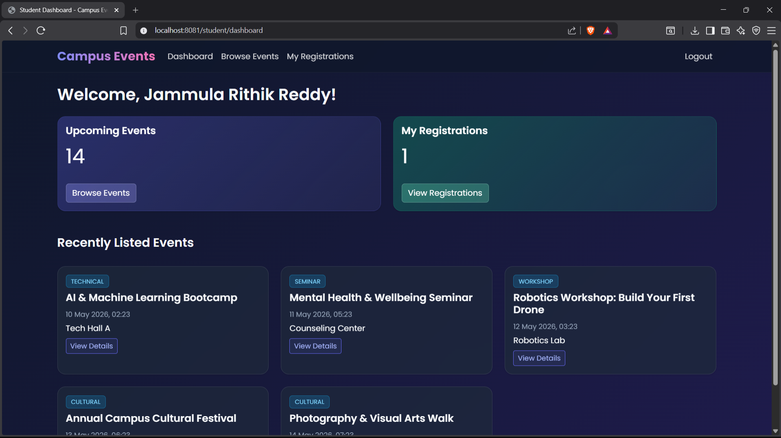
IMPLEMENTATION SCREENSHOTS
HOME PAGE
1
2
3
4
5
6
7
8
9
This is the main entry page of the system. Students can register or log in, and admin can log in from here.

Slide 11
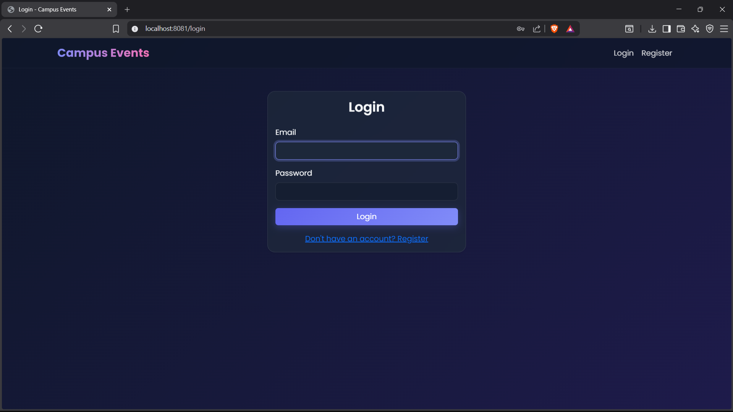
IMPLEMENTATION SCREENSHOTS
ADMIN LOGIN PAGE
1
2
3
4
5
6
7
8(A)
This page allows the admin to log in using username and password. After successful login, the admin can view registration reports.
9

Slide 12
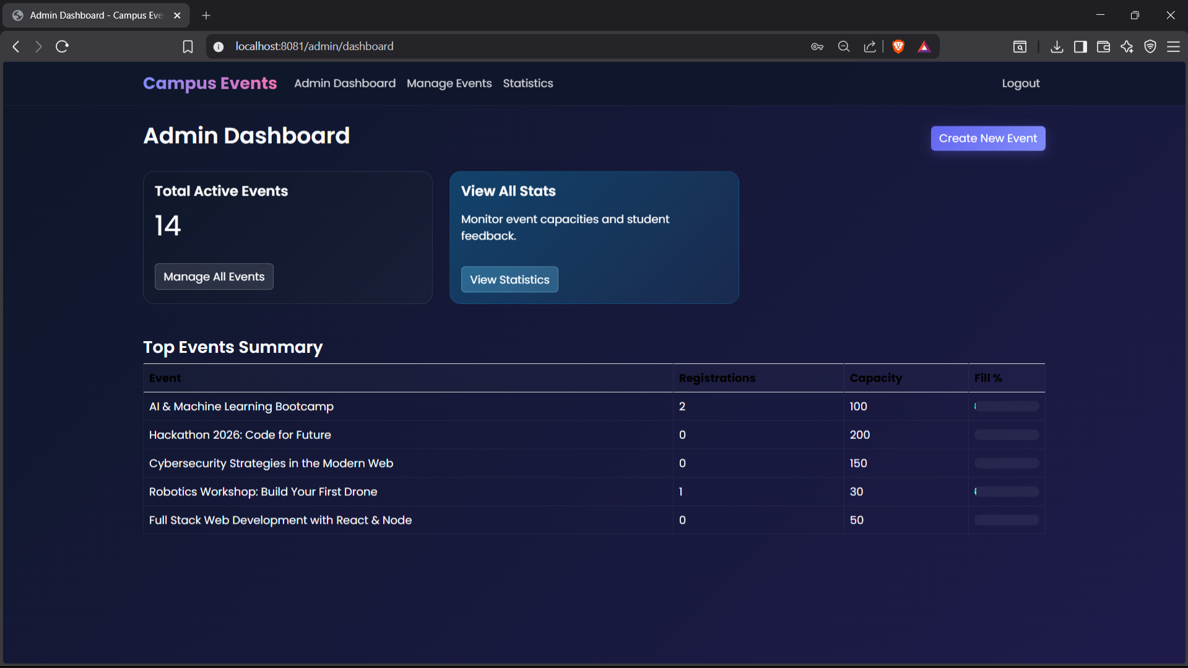
IMPLEMENTATION SCREENSHOTS
ADMIN EVENT REGISTRATION SUMMARY PAGE
1
2
3
4
5
6
7
8(B)
This page displays all event registrations of the students. It shows each event with the total number of registered students and their names.
9

Slide 13
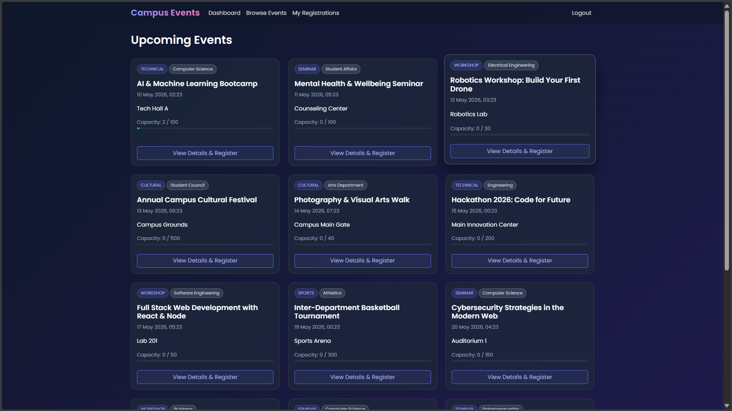
IMPLEMENTATION SCREENSHOTS
STUDENT REGISTRATION PAGE
1
2
3
4
5
6
7
8(C)
This page allows new students to create an account by entering their details. After registration, they can log in and register for events.
9

Slide 14
IMPLEMENTATION SCREENSHOTS
STUDENT LOGIN PAGE
1
2
3
4
5
6
7
8(D)
This page allows registered students to log in using their email and password. After login, they can view and register for available events.
9

Slide 15
IMPLEMENTATION SCREENSHOTS
AVAILABLE EVENTS PAGE
1
2
3
4
5
6
7
8(E)
This page displays all available events with details like date, venue, and description. Students can register for events directly from this dashboard.
9

Slide 16
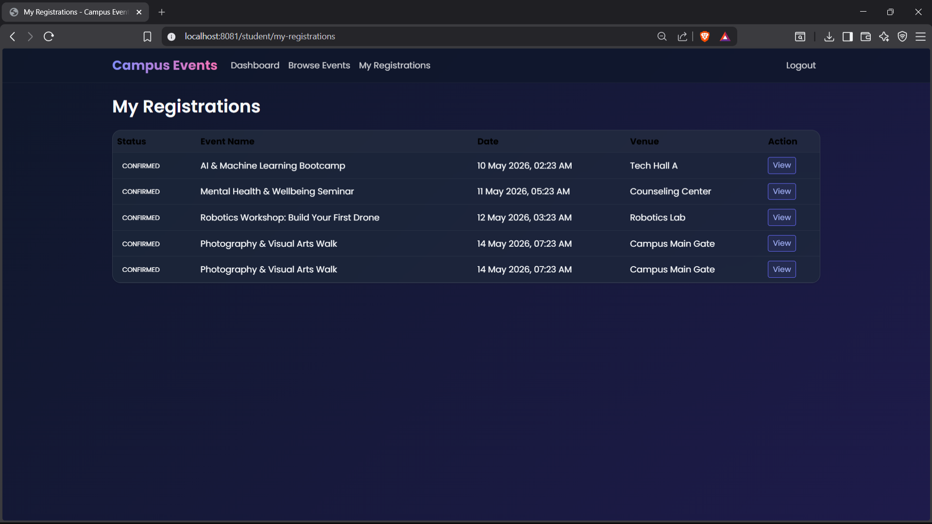
IMPLEMENTATION SCREENSHOTS
STUDENT REGISTERED EVENTS PAGE
1
2
3
4
5
6
7
8(F)
This page displays the events that the student has successfully registered for. It allows students to view their registered event details in one place.
9

Slide 17
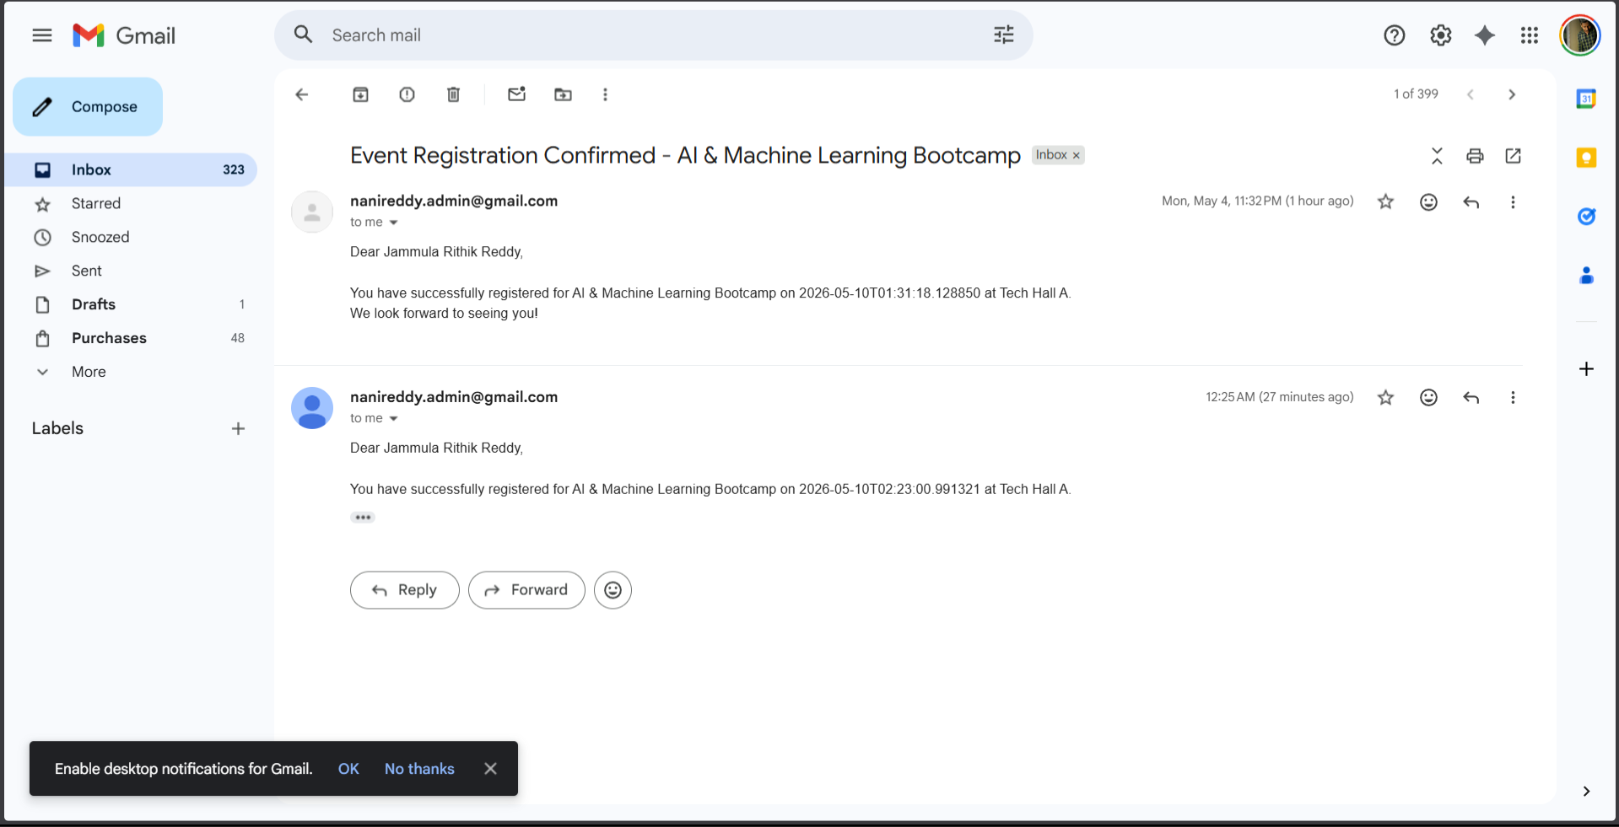
IMPLEMENTATION SCREENSHOTS
EMAIL CONFORMATION
1
2
3
4
5
6
7
8(G)
This page displays the events that the student has successfully registered for. It allows students to view their registered event details in gmail.
9

Slide 18
ADVANTAGES & LIMITATIONS
1
ADVANTAGES:
Reduces manual paperwork and saves time.
Easy event registration for students.
Admin can view reports easily.
Prevents duplicate registrations and checks deadlines.
Centralized database ensures organized data management.
Limitations:
Requires internet and system availability.
Basic security (can be improved with encryption).
Depends on server availability (Tomcat/MySQL).
2
3
4
5
6
7
8
9

Slide 19
Thank you

